Slide 1
Activity Diagrams
CS 3450
Introduction to Software Engineering

Slide 2
What is an Activity Diagram?
Similar to a Use Case, and Activity Diagram helps us visualize activities in a system
These are more in depth, and give a visual representation as to the flow of the activity instead of a textual representation

Slide 3
Why are they needed?
One problem that we face with Use Cases is a situation with multiple branches of flow
Example
When a user starts the chat client, what can they do next?
Chat
View online friends
Read news
How does a user get from logging in, to chatting?
Components of Activity Diagrams…

Slide 4

Beginning and End
Marks the beginning and end of the activity
Arrows should point away from beginning and towards end
Fairly straightforward

Slide 5
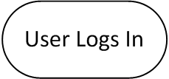
Action State
States what the user has to do to proceed to the next state

Slide 6
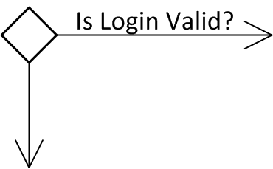
Decision
This is how we show multiple flows
This allows us to make the program do various things based on user input/actions

Slide 7
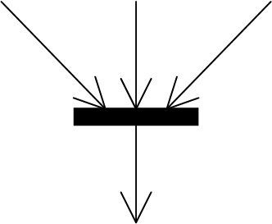
Join
This joins multiple actions together back into one flow
This will be required any time you use a decision because there is only one end point

Slide 8
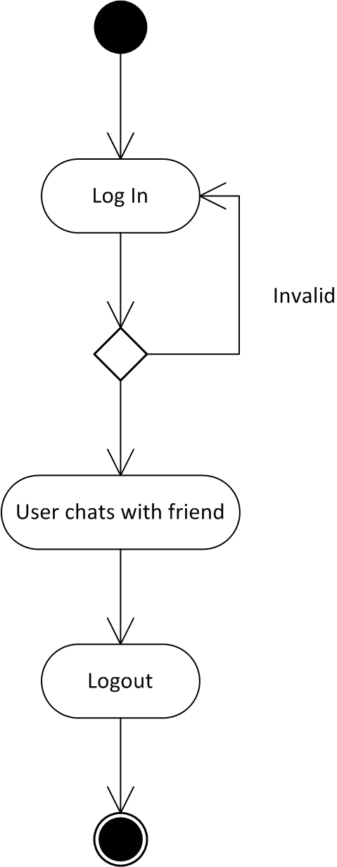
Finished Product

Slide 9
Remember
We will only do a maximum of 10 of these
Arrows should follow the flow. If you ever need to go backwards, put in a decision and point an arrow back up.

